Slide 1
Initial incorporation decisions of U.S.-headquartered firms
Susan Morse
University of Texas School of Law
Presentation prepared for
ITPF/AEI Conference
Economic Effects of Territorial Taxation
March 31, 2014

Slide 2


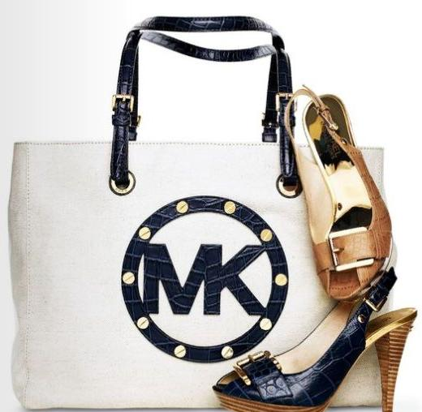
Ways to invert
“[An] Agreement and Plan of Merger and Reorganization (the "merger agreement") … by and between Aon Corporation, a Delaware corporation ("Aon Delaware"), and Market Mergeco Inc., a newly formed Delaware corporation ("Aon Mergeco") and a wholly-owned subsidiary of Aon Holdings LLC, a newly formed Delaware limited liability company ("Aon Intermediate") and a wholly-owned subsidiary of Aon Delaware, pursuant to which Aon Mergeco will merge (the "merger") with and into Aon Delaware, with Aon Delaware surviving the merger as a wholly-owned subsidiary of Aon Intermediate. Aon Intermediate will become, in connection with the merger, a wholly-owned subsidiary of Aon Global Limited, a newly formed private limited company incorporated under English law which, prior to the effective time of the merger, will re-register as a public limited company named "Aon plc" or a similar name ("Aon UK"). Pursuant to the merger agreement, each issued and outstanding share of the common stock of Aon Delaware will be converted into the right to receive one Class A Ordinary Share of Aon UK, nominal value $0.01 per share. Aon UK, together with its subsidiaries, will own and continue to conduct our business in substantially the same manner as is currently being conducted by Aon Delaware and its subsidiaries.”
The hard way: an ex post transaction
The easy way: incorporate outside the U.S. initially

Slide 3
The puzzle
Presentation draws from Allen and Morse (National Tax Journal, 2013); Morse (Florida Tax Review, 2013)

Slide 4
Chinese firms drive observed increase in tax-haven-parented U.S.-based IPOs

Slide 5
47 U.S.-headquartered, tax-haven-incorporated IPO firms out of larger sample of 2911
13 insurance carriers
4 marine transportation firms
Several firms with non-U.S. organic growth
2 global services firms
Several firms with private equity history

Slide 6
Data suggests tax haven-incorporated firms larger and more profitable
No significant result for R&D intensity.

Slide 7
Possible explanations
Insufficient tax advantage for tax haven parent
  Law changes could be adverse to either structure
    Current proposals target insurance, passenger cruise firms
Legal/regulatory advantages for U.S. parent
    Regulatory reasons for some non-U.S. incorporation choices
    Comparison differs depending on non-U.S. jurisdiction
Resource constraints
  Significant disruption necessary to prompt different equilibrium point?

Slide 8
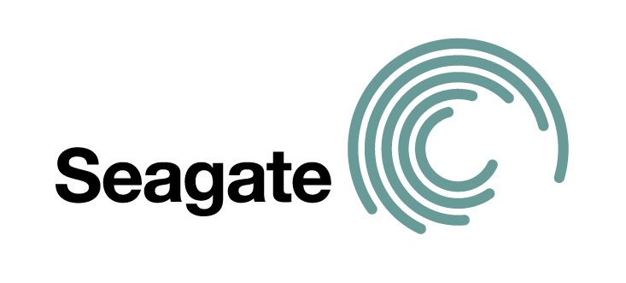


Expanded screen for U.S.-headquartered, tax haven-incorporated firms
 | SDC “Nation” item = U.S. | Principal executive office listed = U.S. | More than 50% U.S. employees indicated in registration statement | More than 50% U.S. floor area indicated in registration statement | More than 50% U.S. revenue indicated in registration statement
Added for each screen | 26 | 1 | 1 | 6 | 13
Running total | 26 | 27 | 28 | 34 | 47

Slide 9
Countries classified as tax havens
Andorra
Anguilla
Antigua and Barbuda
Aruba
Bahamas
Bahrain
Barbados
Bermuda
British Virgin Islands
Cayman Islands
Channel Islands
Cook Islands
Cyprus
Dominica
Gibraltar
Hong Kong
Ireland
Isle of Man
Jordan
Lebanon
Liberia
Lichtenstein
Luxembourg
Macao
Maldives
Malta
Marshall Islands
Mauritius
Monaco
Montserrat
Nauru
Netherland Antilles
Niue
Panama
Saint Kitts and Nevis
Saint Lucia
Saint Vincent and the Grenadines
Samoa
San Marino
Seychelles
Singapore
Switzerland
Tonga
Turks and Caicos
Vanuatu
Virgin Islands
Following Dharmapala and Hines (2009)

