Slide 1


International Tax Policy Forum and
Institute of International Economic Law
Conference at Georgetown University Law Center
Tariffs & Other Destination-Based Levies
June 27, 2025
Slides will be available after the conference on ITPF’s website: www.itpf.org

Slide 2
Agenda
8:00 am Registration and Continental Breakfast
8:30 am Opening Remarks
8:45 am Tariffs
10:00 am Break
10:15 am Supplements and Alternatives to Tariffs
11:00 am How Should Policymakers Approach Tariffs and Alternatives?
12:10 pm Lunch
12:30 pm Keynote Address
1:00 pm Adjourn

Slide 3
Opening Remarks
Itai Grinberg: Georgetown Law
John Samuels: Chairman of International Tax Policy Forum

Slide 4
Tariffs
Moderator: James Hines: University of Michigan
Presenters:
Jennifer Hillman: Georgetown
Presidential authority to levy tariffs
Mary Lovely: Peterson Institute for International Economics
Economic effects of tariffs

Slide 5


Tariffs: The Unchartered Waters of Tax Policy
Jennifer Hillman
Professor from Practice
Georgetown Law

Slide 6
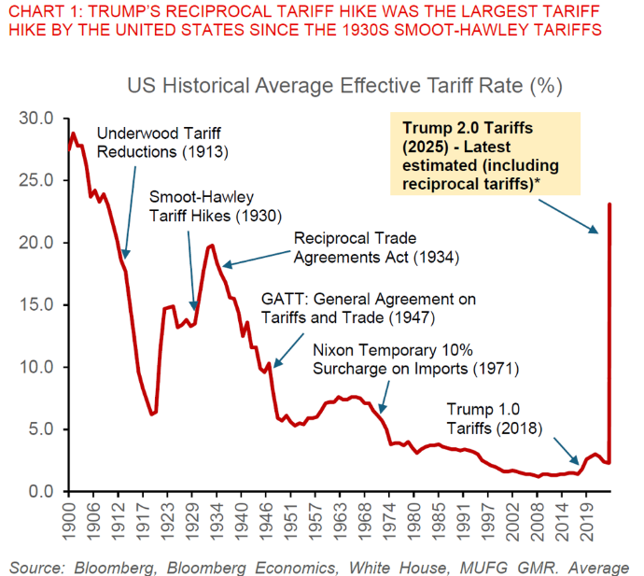

Slide 7



Product | Product | Tariff Level | Effective Date | Legal Authority | Countries
 | Steel and Aluminum | 50% (had been 25%) | March 12 June 4 | Sec. 232 | All (UK may get some exemption)
 | Refrigerators, freezers, washers, dryers, dishwashers, stoves, ovens, disposals, wire rack | 50% | June 16 | Sec. 232 | All
 | Cars and car parts | 25% | April 3 May 3 | Sec. 232 | All UK –TRQ 10% Canada + Mexico deduct value of US content
 | All products except electronics (smartphones, laptops, computer chips, etc.) | 10% | April 9 | IEEPA | All except Canada and Mexico
 | All products | Varied reciprocal rates | Paused until July 9 | IEEPA | 60 countries
 | All products | 25% | April 2 | IEEPA | Countries that purchase Venezuelan oil

Slide 8
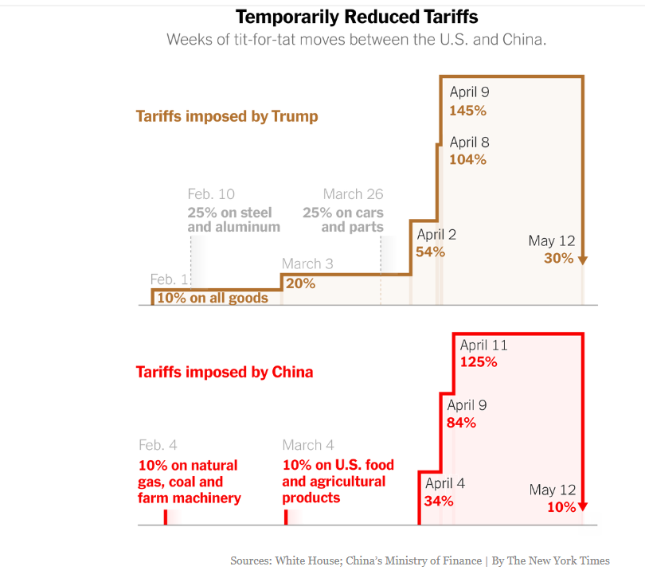
China Tariffs
After the April 12 90-Day Pause
IEEPA tariffs of 30% on all goods from China
50% tariffs on steel and aluminum
25% tariffs on cars and car parts
25%/7.5% tariffs on goods subject to Lists 1, 2, 3, and 4A from 2018 ($360B in imports)
Applied rates: 40%-60%
Elimination of $800 “data-free, duty-free” de minimis

Slide 9
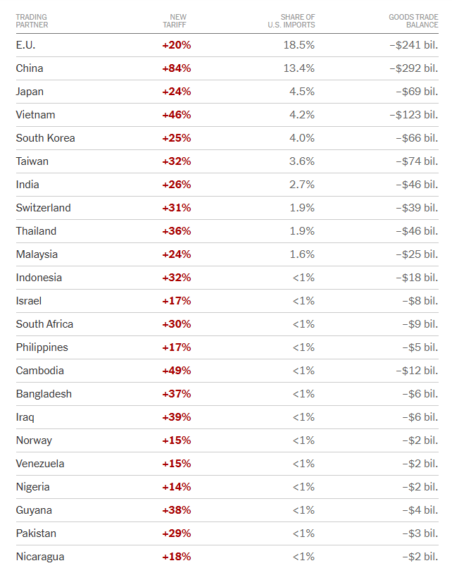
“Reciprocal” tariff rates slated
to be reimposed on July 9

Slide 10
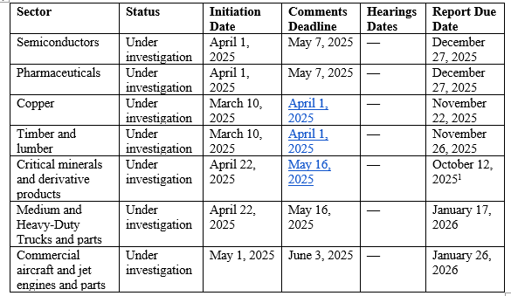
Products Under Investigation –Sec. 232 (National Security)

Slide 11
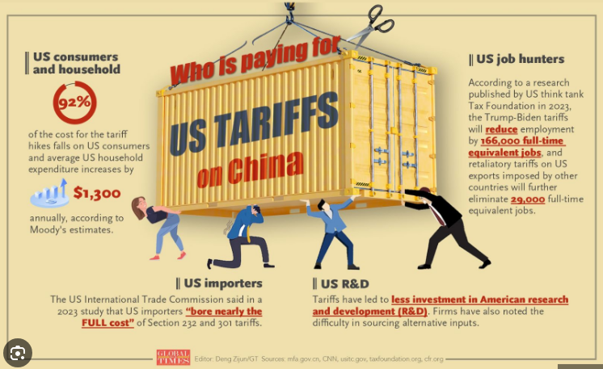

Slide 12
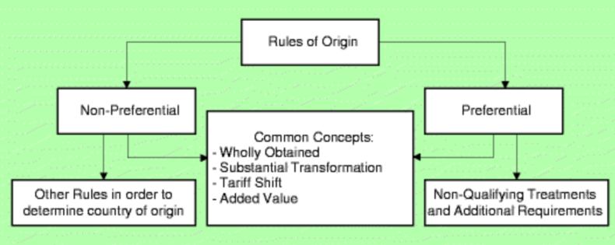

Slide 13
Legal Challenges to IEEPA Tariffs
Primary claims –IEEPA provides power to “regulate importation”
IEEPA does not provide President with authority to impose tariffs. Word “tariff” or “duty” not in statute, none of usual procedures for tariffs included, never been used for tariffs before, requires interpreting “regulate importation or exportation” to mean put tariffs on imports but not exports
IEEPA requires declaration of “unusual and extraordinary” threat but we’ve run trade deficits for 50 consecutive years
Requires that tariffs be “necessary to deal with” declared threat but tariffs on everything from teddy bears to T-shirts are not necessary to “deal with” fentanyl crisis declared with respect to Canada, Mexico and China

Slide 14
Status of Legal Claims
Court of International Trade—ruling on May 28, 2025
--10% baseline + reciprocal tariffs unlawful because tariffs on all goods from all countries exceed any authority granted to the President under IEEPA
--25% tariffs on Canada, Mexico + China unlawful because they do not deal with the threats from fentanyl
D.C. Court—Learning Resources, Inc.—ruling on May 29, 2025
-- all IEEPA tariffs are unlawful because IEEPA is not a law providing for tariffs
-- power to “regulate imports” is not the power to tax or impose tariffs
Both cases on appeal, with duties being collected while appeals are pending.

Slide 15
Solutioning Reciprocal Country Tariffs April 2025
Mitigation Strategies | Potential Tariff Reduction | Comments
Classification Analysis | up to 90% | If the Harmonized Tariff Schedule (HTS) classification of goods can be technically reassigned to a different HTS code with a lower tariff, this may reduce duties.
US Content Determination | Up to 100% of the US content | A systematic US content determination assessing the information across the supply chain can result in compliant meaningful reduction without leakage.
Origin Analysis | up to 100% | Reviewing country of origin under the substantial transformation test or the USMCA rules of origin.
Duty Drawback | up to 99% | For imported goods that are later exported with a similar HTS classification, up to 99% of the duties paid can be reclaimed.
First Sale | Varies by Industry (up to ~30% reduction) | Allows for use of an earlier sale in a multi-tiered supply chain as the basis for customs valuation.
Transfer Pricing Alignment | Varies by Industry (up to ~30% reduction) | Review alignment of transfer pricing and customs value, excluding non-dutiable values were possible.
Foreign trade zone | Deferral / 100% reduction | A Foreign Trade Zone (FTZ) provides several tariff-related advantages: 1) Duty deferral; 2) Duty elimination on re-exports – no duties are paid on goods exported directly from the FTZ to non USMCA countries; and 3) other benefits on fees / quotas
Tariff Exclusions | TBD
Best Practice: A company should analyze their punitive tariffs against each mitigation strategy to help reduce the overall impact.

Slide 16
Available Solutions by Tariff Action
 | Pre-Trump 2025 Duties |  |  |  |  | Trump 2025
Mitigation Strategy | NTR/MFN | China Origin (Sec. 301) | Steel & Aluminum (Sec. 232) | Solar Panels & Washing Machines (Sec. 201) | ADD & CVD | IEEPA | Auto (Sec. 232)
Duty drawback | ✔ | ✔ |  | ✔
Tariff exclusions |  | ✔ | ✔ |  |  |  | [none]
Foreign trade zone duty deferral | ✔ | ✔ | ✔ | ✔ | ✔ | ✔ | ✔
First sale valuation | ✔ | ✔ | ✔ | ✔ | ✔? | ✔ | ✔
Alternative valuation | ✔ | ✔ | ✔ | ✔ | ✔? | ✔ | ✔
Origin shifting |  | ✔ | ✔ |  | ✔ | ✔
FTA / Origin Compliance | ✔ |  |  |  |  | ✔
Tariff classification analysis | ✔ | ✔ | ✔ | ✔ |  |  | ✔
Tariff rate quotas |  |  | ✔ | ✔ |  |  | [none]
De minimis entries | ✔ | ✔ | ✔ | ✔

Slide 17
Competing Rationales for Tariffs
Raise revenue
Create leverage
Reduce the trade deficit
Force the reshoring of manufacturing

Slide 18
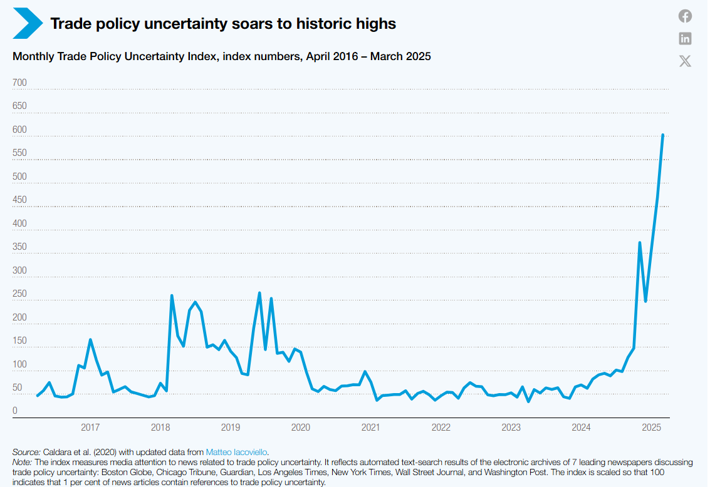

Slide 19
Supplements and Alternative to Tariffs
Moderator: Dhammika Dharmapala: UC-Berkeley
Panelists: Alan Auerbach: UC-Berkeley
The economic consequences of tariffs & other
destination-based taxes
Dan Winnick: KPMG
Digital services taxes & retaliatory tariffs
Paul Oosterhuis: Skadden and Columbia Law School
Taxing cross-boarder services & the new UN Model Treaty Article

Slide 20
The Economic Consequences of Tariffs and Other Destination-Based Taxes
Alan J. Auerbach
June 27, 2025

Slide 21
Issues
What are destination-based taxes and why focus on them?
VAT
DBCFT
Tariffs
DSTs

Slide 22
Conclusions

Slide 23
How Should Policymakers Approach Tariffs and
Alternatives?
Moderator: Michelle Hanlon, MIT
Presenters:
Grant Aldonas: Former Commerce Secretary for International Trade
Lily Faulhaber: Georgetown Law
Jack Mintz: University of Calgary
Steven Vaugh: King & Spalding

Slide 24
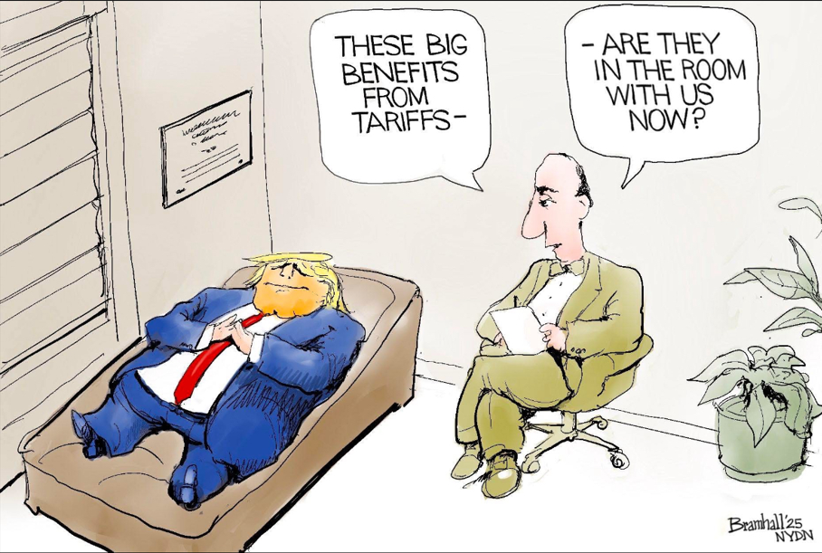

Slide 25
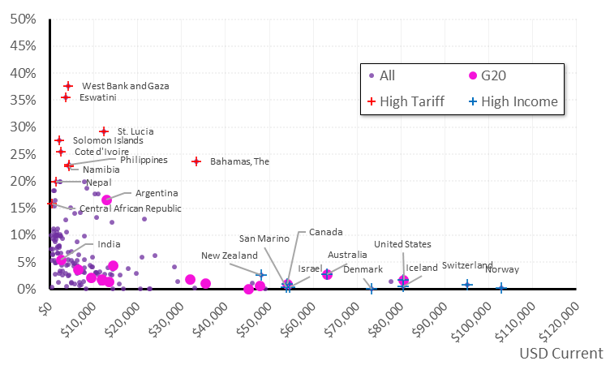
Per Capita GNI vs. Taxes on Trade as a % of Revenue by Country 2023 (or latest year)

Slide 26
Luncheon Keynote Address
Introduction:
John Samuels: Chairman, International Tax Policy Forum
Keynote speaker:
Michael Faulkender: Treasury Deputy Secretary, Acting IRS Commissioner

