Slide 1

10th Annual
International Tax Policy Forum and
Institute of International Economic Law
Tax Conference at Georgetown University Law Center
Tax Sovereignty in 2026 and Beyond
June 12, 2026
Slides will be available after the conference on ITPF’s website: www.itpf.org

Slide 2
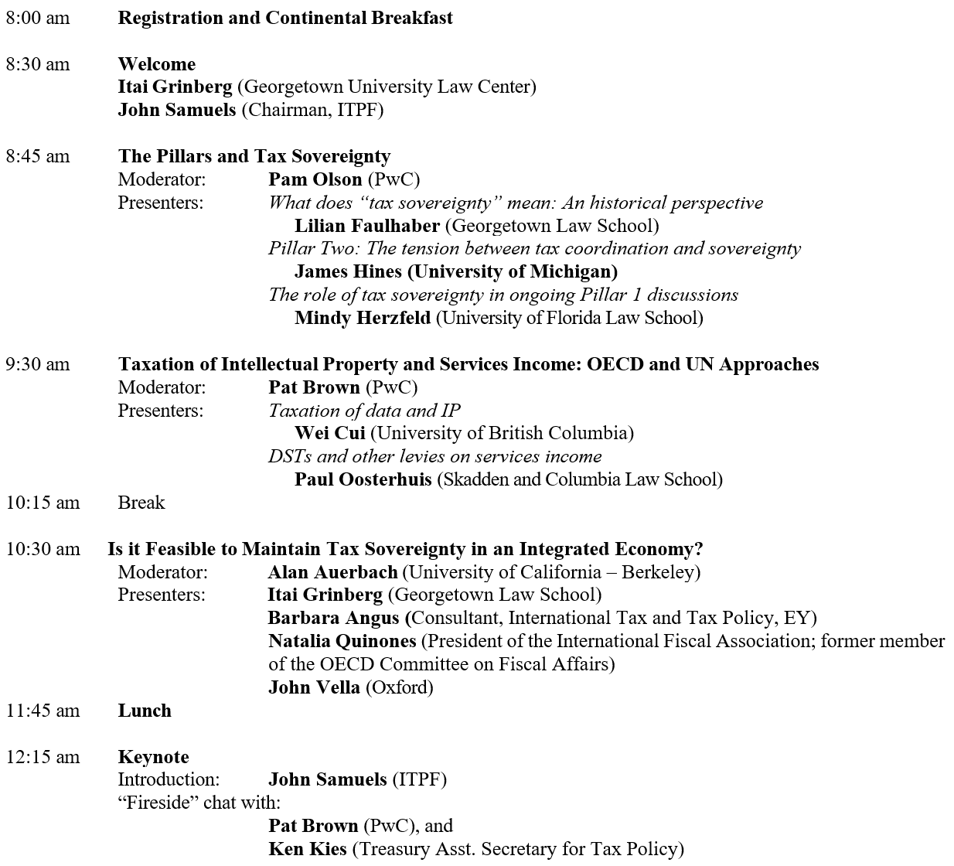
Agenda

Slide 3
Opening Remarks
Itai Grinberg - Georgetown Law
John Samuels - Chairman of International Tax Policy Forum

Slide 4
The Pillars and Tax Sovereignty
Moderator: Pam Olson - PwC
Presenters:
Lilian Faulhaber - Georgetown Law School
What does “tax sovereignty” mean: An historical perspective
Jim Hines - University of Michigan
Pillar Two: The tension between tax coordination and sovereignty
Mindy Herzfeld - University of Florida Law School
The role of tax sovereignty in ongoing Pillar 1 discussions

Slide 5

Tax sovereignty: An historical perspective
Lilian V. Faulhaber
Ralph H. Dwan Chair in Taxation

Slide 6
Historical references to tax sovereignty
1787 Constitutional Convention
  Giving taxing power to the United States government “will necessarily destroy the state sovereignties for there cannot exist two independent sovereign taxing powers in the same community.” (William Findley, quoted in Ring 2008)
Sub-federal entities in Switzerland and Germany (among others)
  1919 and following – debates in Germany over loss of fiscal sovereignty by the Lander in the face of proposed national tax measures
  1950s-1970s - debates in Switzerland over fiscal harmonization and fiscal equalization raised concerns about sovereignty of cantons
States and municipalities in the United States
  1911 – corporate stockholder plaintiff in Flint v. Stone Tracy Co. challenges federal corporate tax as infringement of state sovereignty
  1927 – state plaintiff in Florida v. Mellon challenges federal estate tax as infringement of state sovereignty

Slide 7
More recent references to tax sovereignty
1979 and following – Cassis de Dijon and European Court of Justice cases limiting Member State tax rules under the fundamental freedoms
  Debates over whether Member States of the European Union ceded tax sovereignty to the Court despite retaining veto power over the harmonization of direct tax measures
1997-2006 – WTO rulings on FSC/ETI regime
  Representatives and Treasury officials argued that these rulings violated U.S. sovereignty because they pressured the U.S. to adopt a territorial system
  Some commentators countered that U.S. elected representatives had agreed to this invasion of U.S. sovereignty by permitting U.S. to become a member of the WTO
Late 1990s/ early 2000s – OECD project on harmful tax competition
  Center on Freedom and Prosperity, Congressional Black Caucus, Treasury Secretary O’Neill and others challenge the OECD project on harmful tax competition as threat to sovereignty of countries named as “tax havens”
  OECD member countries countered that the project was necessary to protect their sovereign ability to set their tax rates and fight tax competition

Slide 8
More recent references to tax sovereignty (cont.)
2001 and following – EU proposals for a CCCTB
  Ireland, England, and other Member States argued that a harmonized tax base would “undermine…national sovereignty over tax matters” and “prevent[] the finance minister in each member country from managing the economy in ways that they feel appropriate” (Ring 2008)
  EU Tax Commissioner countered that “there are times when the prospects of improved European competitiveness can outweigh purely national considerations.” (Ring 2008)
2010 and following – Foreign Account Tax Compliance Act
  Taxpayers argued that the U.S. provision imposed rules and requirements that violated the tax sovereignty of the countries where they resided
  U.S. Treasury explanation for FATCA implied that U.S. tax sovereignty over U.S. taxpayers required knowing information about those taxpayers’ accounts
2016 and following – EU state aid decisions limiting Member State tax practices
  Member States argued that EU Commission had violated their tax sovereignty in limiting their ability to provide tax rulings that allegedly reduced revenue collection
  Taxpayers also made this argument alongside Member States

Slide 9
What do these historical references to tax sovereignty tell us about what tax sovereignty is?
Are all claims of sovereignty in tax debates just rhetorical flourishes?
Are some of these claims more or less legitimate than others?
In other words, does tax sovereignty mean something? Or is it just in the eye of the beholder (and/or a more compelling way to disagree with certain tax provisions)?

Slide 10
Some considerations to take into account when considering references to tax sovereignty
What is the relationship between the parties when sovereignty claims are raised?
Who is raising the sovereignty claim?
Are sovereignty claims being made on both sides?
Is there an argument that the party making the claim ceded some of its sovereignty or agreed to abide by the actions of the other party?
What elements of sovereignty are at stake?

Slide 11
Relationships between parties in various disputes
State/sub-federal entity versus federal entity
  U.S. states versus United States
  Sub-federal entities in Switzerland, Germany, and elsewhere
Country versus country
  Some claims for and against OECD harmful tax project
  Some claims for and against FATCA
Country versus international or supranational organization
  Country versus international or supranational organization of which the country is a member
    EU Members States and ECJ rulings
    U.S. and WTO rulings
    U.S. and OECD harmful tax project
    EU Member States and CCCTB proposals
    EU Member States and state aid decisions
    Some of these involve changes of administrations or different levels of government within the country
  Country versus international or supranational organization of which the country is not a member
    Jurisdictions included on the OECD list of tax havens and those with harmful tax practices

Slide 12
Who raises claims of tax sovereignty?
Sub-federal entities on behalf of themselves
  U.S. states in 1787 and 1927
  Swiss cantons, German Lander, and other sub-federal entitites
Countries on behalf of themselves
  U.S. defenses in WTO dispute
  Countries defending themselves against OECD harmful tax project
Countries on behalf of other countries
  U.S. claims against OECD harmful tax project
  U.S. criticisms of Apple state aid case
Citizens or taxpayers
  1911 challenge to U.S. federal corporate tax
  EU taxpayer criticisms of CCCTB and ECJ cases
  Taxpayers rallying countries and legislators against OECD harmful tax project
  2014 FATCA case brought against Canada
  Apple statements about state aid on behalf of Ireland
Individual legislators within countries
  Pillar One/Pillar Two debates

Slide 13
Are tax sovereignty claims being made on both sides?
Tax sovereignty defenses made on behalf of international/supranational organizations
  OECD harmful tax project: low-tax jurisdictions are threatening the ability of OECD members to exercise tax sovereignty, so collective action is necessary
  FATCA: jurisdictions that allow account secrecy threaten the ability of the U.S. to exercise tax sovereignty
Tax sovereignty defenses made on behalf of individual countries
  Individual country sovereignty means that countries can design their tax system as they see fit, regardless of how it affects other jurisdictions

Slide 14
Did one side cede some portion of their sovereignty?
Debate over IR theory of whether any country ever has complete sovereignty – countries are always affected by actions by other countries
This is even more true as countries turn to international/supranational organizations
Ongoing question within this debate over when countries or states cede sovereignty to international or supranational organizations, who has the power to cede that sovereignty, and how much sovereignty a country or state can cede
  EU debates: how much control did Member States retain over their tax systems?
  WTO and OECD debates: did joining these organizations mean that Congress lost part of its ability to shape the U.S. tax system?
  Federalism debates in U.S. and other countries: how much control did states retain over their tax systems?

Slide 15
What elements of sovereignty could be at stake?
Raising revenue
  Often referred to as the clearest example of how tax is inherent to sovereignty
  Not always at stake, at least not directly – see OECD harmful tax project, EU state aid cases, WTO dispute over FSC/ETI, and CCCTB, where countries wanted the ability to keep their rates lower
Controlling fiscal policy
  More general idea of control over the tax system
  But also raises the issue that countries generally don’t have complete control over fiscal policy since they are affected by other countries’ actions
Democratic accountability and legitimacy
  Argument that international and supranational organizations are not accountable to a group of voters or taxpayers and/or were not given authority over certain areas
  But organizations argue that democratically elected legislatures supported entrance into the organizations and that they protect the ability of jurisdictions to protect themselves from entrenched interests or other jurisdictions’ policies
Preference for local control and diversity of tax systems
  Argument against harmonization by international and supranational organizations
  But not all sovereignty claims raise this since some are against individual countries
(See Ring 2008 for more discussion of the elements of sovereignty in tax)

Slide 16
So…what is tax sovereignty?
Generally invoked when the substance of the rule or decision in question is offensive to the party invoking it (see Ring 2008)
  Not often invoked when the claimant supports the substance of the underlying rule or decision
But questions in previous slides suggest sovereignty claims are not just critiquing the underlying rule or decision
They’re also expressions of frustration about a loss of voice and a change in the balance of power between parties
  States and sub-federal entities highlighting that federalism has gone further than expected despite efforts to put up guardrails
  U.S. legislators and officials highlighting that dispute resolution rules at the WTO didn’t give them veto power
  EU Member States highlighting that their efforts to retain veto power over tax matters did not mean they retained full control over tax matters
  Countries highlighting that they do not have complete sovereignty given the effects of other countries’ actions
  Taxpayers highlighting that elected officials imposed or agreed to rules that seemed to target them rather than representing them
  Republican legislators highlighting that they didn’t have a voice in the Biden Treasury’s negotiations at the OECD
And asking these questions can clarify what critiques are really being made

Slide 17
Taxation of Intellectual Property and Services Income: OECD and UN Approaches
Moderator: Pat Brown - PwC
Presenters:
Wei Cui - University of British Columbia
Taxation of data and IP
Oosterhuis - Skadden and Columbia Law School
DSTs and other levies on services income

Slide 18
Taxation of Data and IP
Wei Cui
Peter A. Allard School of Law
University of British Columbia
Georgetown/ITPF
June 12, 2026

Slide 19
Three perspectives (from 2026) on the DST debate
The U.K. and E.U. proposed DSTs in 2018. What do advances in scholarly research since then say about how to conduct the DST debate?
Three perspectives:
  Contested norms for measuring income
  What do we want to tax with DSTs?
  International tax when the most important assets do not move

Slide 20
Contested norms for measuring income
“DSTs are crude;” but how do we feel about “the income tax”?
Economic growth now crucially depends on intangibles—not only knowledge capital (IP) but also organizational and customer capital (Belo et al 2022, Crouzet & Eberly 2023). These are seriously mismeasured by traditional accounting rules, leading to mismeasurements of both investment and returns (Lev 2019, Ayyagari et al 2024).
  Tangible asset expensing combined with interest deductions also introduces serious mismeasurements.
Measurement issues arising from intangibles, and the related question of explaining losses (“negative residual profits”), are neglected or unresolved by tax literature (Beer et al 2023)
Even in a domestic context, how should we evaluate a low-rate tax on zero-marginal-cost output v. a high-rate tax/subsidy on investment?

Slide 21
What are we taxing with DSTs?
All Mode 1 services trade, whether on digital platforms or not, whether automated or not. But why?
The original DSTs are much narrower (online advertising, online marketplaces, and social media). Their rationales can be taken to be much more specific: two-sided business models where source of platform profit (user attention) may be mis-aligned with sources of payment.
  DSTs are taxes on location-specific platform rent that cannot be reached with other taxes by the relevant countries (Cui 2019).
  Network effects are crucial.
The AI space looks very different:
  Traditional economy of scale (hyper-scalers) much more important.
  Data feedback loops may or may not exist, but are in any case distinct from network effects.
  Many platform models may be disrupted by AI, e.g., Google search and Uber (Hagiu & Wright 2025)

Slide 22
What are we taxing with DSTs? (continued)
Take the idea of “taxing data”. How important are transactions in data as a tax base?
  Reddit earns >90% of revenue from advertising, but licenses data to Google and OpenAI.
  The advertising revenue is for user attention, not data in itself.
Unlike a tax on platform rent, “taxing data” does not have any good theory behind it.
  Much raw data (e.g., those used to train foundation models) is non-unique and “high entropy” (Mihet et al 2025).
  Though perhaps zero-marginal cost to generate or maintain, it is not clear that data is a significant source of rent (Liu et al 2026)
  Sharing of processed data may be important to maintain competition (Gans 2026)

Slide 23
International tax when the most important assets do not move
DSTs may have just been a wake-up call to the prevalence of location-specific rent arising from the non-rival deployment of productive intangibles.
  A technology invented can be simultaneously deployed profitably in many places
  When this happens, the “costs of higher taxes are collectivized” (Hines 2023). But is this special to DSTs, or does it apply to all taxes?
  Dyrda et al (2026): U.S. tax decreases (TCJA) have positive spillovers elsewhere; U.S. tax increases (GILTI) have negative spillovers elsewhere; global minimum taxes elsewhere have negative spillovers in the U.S.
    Note the signs of the externalities: in contrast with tax rate competition traditionally understood, where tax increases (decreases) have positive (negative) externalities on other.

Slide 24
International tax when important assets do not move (continued)
The key feature of intangible assets is non-rivalry, not mobility.
  Legal ownership of IP can be “moved” among fictional entities, but so can legal ownership of farms and cattle.
IP, especially patents, copyrights, and trademarks that can be licensed, represents a small portion of MNEs’ valuable intangibles (Davies and Markusen 2021).
  Hard to see how the same licensing fee paid to a high tax jurisdiction is a regular payment but profit shifting when paid to a low tax jurisdiction.
  More importantly, the focus on IP potentially understates the importance of intangibles and potentially mis-represents the fundamental problem: the lack of international cooperation may result in too much, not too little, taxation.

Slide 25
Comments welcome! wei.cui@ubc.ca https://papers.ssrn.com/sol3/cf_dev/AbsByAuth.cfm?per_id=633741

Slide 26
History Of Source Rules
Source rules when first created were intuitive:
Rents: because relates to the use of tangible property, location of property established the source of income from the property
Royalties: followed rents as a payment for the use of property
Services: most were truly personal - performed by people - and sourced at their location of performance
            Special rules for communications and transportation

Slide 27
Sensibility Of Source Rules For Royalties
For rents and services the rules were intuitive based on physical presence
But property “used” in generating royalties has no physical presence; presence is “legal”
In looking through various sources, I struggled to find any that emphasized or even acknowledged that distinction
Even when T.S. Adams led the Senate Finance members through the proposed 1921 Act source of income rules, he always used rents and royalties in the same sentence.
  He spent 18 days with Committee members going through the bill section by section, with no other staff asking or answering questions. How different from TCJA …

Slide 28
Method Of Taxing Locally Sourced IncomeTo Non-Residents Was Not Uniform
In some countries so-called “scheduler” taxes, which were final taxes on revenue streams, preceded net income taxes
  Great Britain and France had such taxes on both residents and non-residents
  Once net income tax developed, it folded in rents and royalties for residents; scheduler taxes remained for nonresidents
In the U.S., we had no scheduler taxes; our net income tax was created after the 16th amendment overturned Pollack; rents and royalties were part of U.S. source income starting in the 1921 Act
  Nonresidents could file a net income tax return; withholding was not a final tax until the 1936 Act
  Net income filing election for real estate rents was first adopted in 1966 Act
For German Federal tax, nonresidents could generally file for net income tax to reduce the withholding tax on rents and royalties until

Slide 29
Since The Mid-1930s Rent And Royalty Withholding Taxes Have Been Imposed As Final Taxes By Most Countries
Commentators back to the 1920s acknowledged that few paid rent withholding tax because could structure to have sufficient presence
For royalties that structuring is more difficult without changing nature of local operations
Only justification for royalty withholding tax was that:
  lower withholding rate made the tax equivalent to net income tax ; and
  tax was not passed forward because of competition with local taxpayers subject to net income tax
Of course, many treaties reduce or eliminate withholding rates on royalties and taxpayers can sometimes avoid paying them, but where they apply, I believe neither condition holds today

Slide 30
Royalty Statutory Withholding Rates
No source exists to demonstrate the fact that over the past 25 years reductions in royalty withholding tax rates have not kept pace with reductions in corporate net income tax rates in most countries
  United States’ 30% withholding rate is an extreme example
OECD did 2022 survey of withholding taxes imposed by its 38 members and 74 additional IF participants:
  18 of 112 countries did NOT impose statutory withholding taxes, most are “investment hubs”
  For rest the average rate is slightly over 15% with range from 10-30%

Slide 31
Arguably These Rates Cannot Be Justified As A Proxy For Net Income Tax Rates
Given our net income tax rate of 21% and an OECD average rate close to 25%, royalty withholding taxes in the 10-20% range means that few royalty recipients are paying less than net income amount
As an example, few companies have operating income in excess of 30% of revenues.
A 25% net income tax rate on 30% margin equals 7.5% of revenues
Very few statutory withholding rates are that low.

Slide 32
Withholding Rates That Create Liabilities Higher Than Net Income Tax Liabilities Are A Problem
Most often in today’s world there is no local competition, so the withholding tax is really similar to a value added tax or excise tax and is potentially passed on to recipients
Even if there is vigorous local competition, the excess tax discriminates against cross-border activity, at least where the royalty recipient country does not grant a full tax credit for the withholding tax.
Not all countries grant a full credit for these withholding taxes

Slide 33
What About Withholding Taxes On Services?
As discussed above, they did not exist back in the 1920s given source rules
Not clear when they started, but were sufficiently present that were given a specific example as a creditable foreign tax in the 1983 Final Regulations
India imposed tax on “technical” services going back at least to the 1960s, and we agreed to permit it up to a 20% rate in our treaty signed in 1989
The UN Model Treaty adopted Article 12A in 2017 after at least 5 years of discussion recognizing that many less developed countries impose them
  Also applies to “technical” services: which included managerial and advisory – all business related

Slide 34
A Surprisingly Large Number Of Countries Impose Some Form Of Services Withholding Tax
OECD 2022 data break out “management” and “technical” services as separate categories.
  Half of OECD members and over 2/3s of other IF members impose some tax
  Data somewhat suspect on source
Baker & McKenzie survey of 120 countries concluded that 72 of them impose some form of withholding tax on payments to non-resident service providers

Slide 35
Impact On US Taxpayers Has Been Modest
SOI data from 2022: U.S. corporate taxpayers paid $2 billion in general basket creditable foreign taxes on services income.
Only corporate taxpayers and direct section 903 credits; no data on CFC or individuals’ withholding taxes
If add up withholding taxes claimed as direct credits on royalties and services by U.S. corporate taxpayers, the total approaches $8-9 billion, which is not insignificant - over a 10-year budget period would clearly be over $100 billion

Slide 36
These Services Taxes Are Predominantly Not DSTs
Very few DSTs imposed in 2020
Many are structured like the UK and French DSTs to be an additional tax, deductible by residents against net income tax
With the revisions to the 1983 regs that survive the recent Notice, these taxes are pretty clearly not creditable from 2022
But others can be like the 2020 Indian Equalization Levy, which is purely a non-resident withholding tax and is likely creditable under the currently applicable regulations

Slide 37
These Services Withholding Taxes Are Not Proxies For A Net Income Tax
OECD data from 2022 show a range of services withholding tax rates from 10% to 35%
No doubt many of these services are management-type services so are low margin activities
Result is serious over-taxation: if activity cost is 100 and charge a 10% markup, revenue is $110 and profit $10; even a 10% withholding tax eats up the profit
Ironically, the same is not so true of DSTs: France has a 3% additional tax; India a 2% nonresident tax

Slide 38
The Desire To Impose Non-Resident Services Withholding Taxes Is Understandable
Historically the line between providing “technical services” and “use of IP” has been difficult in B2B world and subject to much discussion
In today’s internet world these difficulties apply to consumer transactions as well: categorizing software content that can be temporarily downloaded on a device as a royalty or rent, while the same content accessed only via the cloud is a service, is a distinction only lawyers can love
As more services we think of as “personal” become automated (e.g. legal and accounting), including through the use of AI, these difficulties will only expand

Slide 39
Addressing These Taxes Requires A New Multinational Effort, Potentially Led By IF
The project should begin with the premise that taxing a broad range of non-resident services and royalties in the payor jurisdiction is appropriate where bilateral or multilateral agreement exists
  Similar to UN Model Treaty Articles 12 and 12A
But any tax should adopt the concept underlying UN Model Treaty Article 12B, which provides that income recipients have the option to file on a net income basis
The goal would be to establish an international consensus that withholding taxes on rents, royalties and services should only be acceptable if accompanied by a net income filing option
  Digital services taxes would need to be converted to be permitted

Slide 40
Of Course, Article 12B Does Not Apply Arms Length Pricing To Determine Net Income
Instead, it adopts a formulary allocation of income to the service recipient jurisdiction
The formula starts with global business segment revenues and operating profits, applies that % to local revenues as the deemed net income from the local services and then splits that profit 30% to the services recipient jurisdiction with the rest to the service provider jurisdiction

Slide 41
The Pillar 1 Experience Teaches 2 Lessons:
First, any measurement under a net income election for services and royalties has to be formulaic
Second, the possibility of getting agreement on the necessary formulas is more realistic than I would have thought four or five years ago.
Any formulas will have to, in some circumstances at least, deviate from Article 12B because the provision would apply to intercompany transactions as well as third party transactions
But as applied to third party transactions, Article 12B’s formula is a good place to start: it does allocate net income and does so in a manner not that dissimilar from Amount A.

Slide 42
Break

Slide 43
Is it Feasible to Maintain Tax Sovereignty in an Integrated Economy?
Moderator: Alan Auerbach - University of California – Berkeley
Presenters:
Itai Grinberg - Georgetown Law School
Barbara Angus - Consultant, International Tax and Tax Policy, EY
Natalia Quinones - President of the International Fiscal Association; former member of the OECD Committee on Fiscal Affairs
John Vella - Oxford

Slide 44
IS IT FEASIBLE TO MAINTAIN TAX SOVEREIGNTY IN AN INTEGRATED ECONOMY?
Five Propositions
1
There is no tax sovereignty apart from sovereignty itself. A polity that is sovereign is tax sovereign; a polity that is not sovereign, is not tax sovereign.
2
Taxes that are inconsistent with international tax principles or with multinational agreements are nevertheless consistent with tax sovereignty.
3
Tariffs are taxes (i.e. taxes on imports, generally discriminating by origin).
4
A rules-based economic order is a framework in which sovereigns agree to limit certain exercises of economic authority, including in taxation, in exchange for reciprocal benefits they could not secure alone.
5
Agreeing to cooperate — including to constrain one’s own country — can itself be an act of tax sovereignty, whether the agreement is about tariffs or digital taxation or international corporate income taxation.

Slide 45
Is it feasible to maintain tax sovereignty in an integrated economy?
John Vella
University of Oxford
International Tax Policy Forum
Washington DC
12 June 2026

Slide 46
Geographically Expansive Taxes
Definition: Taxes with a weak connection between the taxing country and the taxpayer or the tax base.
Examples
Existing Taxes | Proposals
UTPR Offshore Indirect Transfer of Assets Regimes UK Inheritance Tax Tail UK Offshore Receipts in Respect of Intangible Prop UK Temporary Non-Resident Rule UK Carried Interest Taxation Regime Germany IP Registry cases Kenya Tax on Derivatives Ecuador CIT surcharge | EU Commission Financial Transaction Tax G20 Coordinated Minimum Effective Taxation Standard for UHNW Individuals Zucman’s Oligarch Tax Brain Drain Tax Israeli IDF Tech Unit Tax

Slide 47
Geographically Expansive Taxes
“rather than fearing extraterritoriality, countries should embrace it as a tool for enforcing minimum standards, curbing inequality, preventing tax evasion, and promoting sustainability.”
  Gabriel Zucman, ‘America’s Oligarchs are Trump’s Achilles Heel’, Project Syndicate, 28 February 2025

Slide 48
Lunch

Slide 49
Keynote
Introduction: John Samuels – International Tax Policy Forum
"Fireside" chat with:
Pat Brown – PwC, and
Ken Kies – Treasury Assistant Secretary for Tax Policy

Slide 50
Adjourn

