Slide 1

Repatriation of Foreign Profits:
The U.S. Multinational Experience
C. Fritz Foley
Harvard Business School

Slide 2
US International Tax System
Assume tax rates are: t^{F} = 20%; t^{US} = 35%
Earns $100,
Pays $20 to foreign govt.
Foreign
Sub
Controlling stake
US
MNE
Repatriates $80
Owes US tax of ($100 x 35%)=$35,
less foreign tax credit of ($100 x 20%)=$20
→ additional US tax = $15

Slide 3
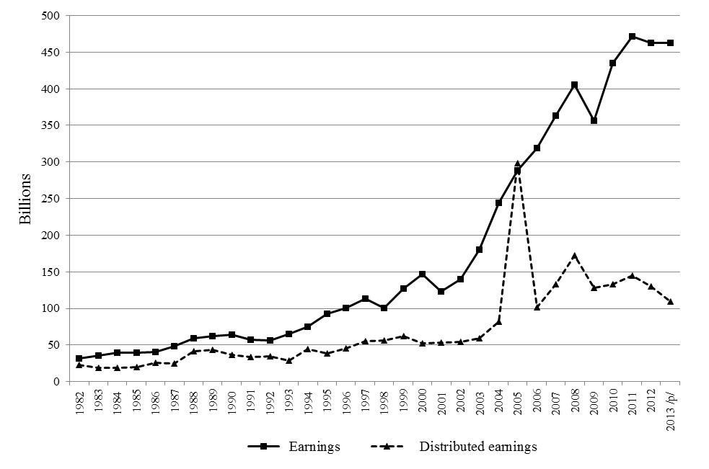
U.S. MNC Earnings and Repatriations

Slide 4
Key Questions
What drives dividend repatriation decisions?
What repatriation related burdens does the current system of taxation create?
How did firms respond to the temporary reduction in repatriation taxes associated with HIA?
What implications does analysis of repatriation behaviors and the response to HIA have for potential policy reform?

Slide 5
What Drives Repatriation Decisions?
Dividend repatriations follow process of partial adjustment
  MNCs appear to set target payout ratio for affiliates
  Adjust payouts in response to changes in earnings
  Same process characterizes dividends to shareholders
Tax considerations are influential
  Evidence from before HIA
    Highly taxed directly owned subsidiaries have higher payout ratios
    The payout ratios of branches do not vary with tax rates
    Neither do the payout ratios of indirectly owned affiliates
  Evidence from HIA
    Repatriations surge during the holiday
    Repatriations from low tax jurisdictions increase the most

Slide 6
What Drives Repatriation Decisions?
Parent financing needs matter
  A portion of dividends to shareholders appears to be funded with repatriations
  Payouts are higher when parents have high levels of leverage and face attractive growth opportunities
  Anecdotally, repatriations provided an important source of liquidity during the recent crisis
Agency considerations are also relevant
  Partially owned affiliates are more likely to pay dividends
  And to engage in explicitly tax-penalized behavior

Slide 7
What are the Current Burdens?
Dividend flows are lower than they would be under a territorial system
  One estimate: 1% lower repatriation taxes is associated with 1% more dividends
  2009 effective foreign tax rate estimates:15%-25%
  Implication: repatriations would be about 10-20% higher
Removing distortions would yield welfare gain
Distortions also appear in patterns of cash holdings
  Firms facing higher tax costs of repatriating foreign income have higher cash holdings
  Cash is often held in US Treasuries and is a part of the US banking system

Slide 8
Cash Holdings and Repatriation Taxes

Slide 9
Cash Holdings and Repatriation Taxes

Slide 10
What are the Current Burdens?
Repatriation taxes reduce competitiveness in market for corporate control
Complexities in organizational structures create inefficiencies

Slide 11
Organizational Complexity

Slide 12
How Did Firms Respond to HIA?
HIA Passed Oct. 22, 2004 as part of AJCA
Allowed companies to deduct 85% of their repatriations from US taxes for one year
  Aim to bring cash and passive investments held abroad back to US
  Focus: create jobs and raise investment
    Period of “jobless recovery”
  Also linked to WTO case
Notes:
Pharmaceutical and high-tech lobbyists sought tax breaks on repatriations as early as 2002. Proposal only started to gain momentum in spring of 2003 when several members of Congress supported including it in a tax-cut bill (especially after realizing it could initially increase revenues). Key factor was weaker economy in first half of 2004. Also a key motivation for AJCA was to offset the effects of the repeal of a tax subsidy for US exporters that was illegal by the WTO.

Slide 13
Taxes Under HIA
Assume tax rates are: t^{F} = 20%; t^{US} = 35%
Earns $100,
Pays $20 to foreign govt.
Foreign
Sub
Controlling stake
US
MNE
Repatriates $80
US taxable income is ($100 x 15%)=$15
Owes US tax of ($15 x 35%)=$5.25,
less foreign tax credit of ($15 x 20%)=$3
→ additional US tax = $2.25 (versus $15)

Slide 14
How Did Firms Respond to HIA?
Significant increase in repatriations after HIA
No association with increased US capital expenditures, US employment, or R&D
  Even for firms that lobbied for the Act or appear to be more financially constrained
Significant association with higher payouts to shareholders
  One study: $1 increase in repatriations associated with $0.79 increase in share repurchases and $0.15 increase in dividends
  Another study: for each $1 in repatriations, $0.54 went to cash acquisitions
Notes:
Go over very quickly….

Slide 15
Are the Responses Sensible?
US MNCs are unlikely to be financially constrained
  MNCs have lower measures of constraints
  Such firms are likely to be able to obtain funding for domestic growth opportunities
  Reduced cost of accessing one type of internal liquidity unlikely to spur investment
US MNCs are likely to be well governed
  Return capital to shareholders when opportunity arises

Slide 16
What are the Implications?
Many burdens of current policy could be reduced
  Firms likely to have higher repatriation payout ratios
  Capital likely to be invested more efficiently
    Firms will not have an incentive to stockpile cash in low tax locations
    Money returned to shareholders would be consumed or reinvested
  Organizational forms could be simplified
Potential concerns
  Firms would have stronger incentives to engage in transfer pricing
    Effects of HIA on income shifting appear to be modest
    But effects might be larger if policy reform were permanent
Notes:
Go over very quickly….

