Slide 1
The Global Minimum Tax and the taxation of MNE profit
ITPF/Georgetown Law Conference
Washington DC, 5 April
Felix Hugger, Ana Cinta Gonzalez Cabral, Pierce O’Reilly
OECD Centre for Tax Policy and Administration

Slide 2
Context
The OECD has carried out extensive economic impact assessment (EIA) of the two-pillar solution
The design of the Global Minimum Tax (GMT) has changed significantly since the release of the first EIA in 2020 – need for an update
Two newly released working papers released contain new evidence launched 2023 and 2024
The work has a global scope (222 jurisdictions are part of the analysis)
Focuses on effects on four key dimensions: 1) tax rate differentials; 2) profit shifting; 3) low-taxed profits; 4) revenue gains

Slide 3
What we are doing
Build a unique matrix of the location of profit and economic activities of in-scope MNEs on a jurisdiction-pair basis
  Data for 2017-2020, largely CbCR based, with imputations for missing variables
Account for the heterogeneity of ETRs within jurisdictions – new evidence on low-taxed profits
Apply the GMT
  Including rule order, Substance-Based Income Exclusion (SBIE), funds exclusion, deferred tax accounting, interactions with US GILTI regime, UTPR allocation key
Provide for MNEs responding by reducing shifted profit
Provide for jurisdictions responding by topping-up domestic low-taxed profit
Assess impacts on tax rate differentials, low-taxed profit, shifted profit, and tax revenue

Slide 4
What we are not doing
Data
  Based on macro aggregates, not firm level data
Rules
  No accounting for the Subject to Tax Rule
  Limited accounting for a variety of adjustments made to financial accounting profit & taxes that are part of the GloBE Rules
Responses
  No live tracking of implementation
  No accounting for jurisdiction responses in terms of expanded subsidies, expanded use of accelerated depreciation or other tax incentives
  No accounting for potential investment impacts at global or jurisdictional level
  No links between profit-shifting and real activity

Slide 5
Assumptions and methodology (1)
New methodology to look at variation of MNEs’ ETRs across jurisdictions
Average ETRs may mask heterogeneity across firms within jurisdictions that can be due to firm circumstances or tax policies (e.g., tax incentives)
We estimate an ETR distribution across MNE profit within each jurisdiction based on CbCR ratio data gathered from tax administrations
Distributions of MNEs’ ETRs are used to map MNE profit distributions
Low-taxed profits, taxed below 15%, are common across all jurisdictions
~60% of low-taxed profits are outside of investment hubs

Slide 6
Assumptions and methodology (2)
GloBE ETR and tax base: GloBE income approximated by aggregated data on global allocation of MNE profit
Key adjustments:
  GloBE income corrected for potential double counting issues in aggregated CbCR data (with some caveats)
  GloBE ETR adjusted for losses, as in GloBE rules; assumption that other adjustments, e.g. due to accelerated depreciation, largely wash out
  Fund exclusion accounted for (other exclusions have little impact on global results)
  GloBE Income adjusted for SBIE
  Interaction of GloBE and GILTI modelled
Most of these adjustments reduce headline revenue estimates, but important to gain an accurate picture

Slide 7
Assumptions and methodology (3)
Six profit-shifting scenarios regarding the elasticity of tax base relative to tax rate differentials
Four implementation scenarios modelled
  Global implementation
    All jurisdictions are assumed to implement QDMTT, IIR, UTPR
  Partial implementation
    Most members of the Inclusive Framework on BEPS (IF) are assumed to implement QDMTT, IIR, UTPR with probabilities of 70%, 85%, or 100%
    Except IF members with 1) no CIT infrastructure and 2) no public signal of GloBE implementation
    Non-IF member jurisdictions are assumed to not implement

Slide 8
Reduction in profit shifting
Percentage change in location of profit due to reduced profit-shifting
The GMT is estimated to reduce ETR differentials between investment hubs and non-hubs by around 50%, from 14 percentage points to 7 percentage points on average
Lower tax rate differentials reduce MNEs’ incentives to shift profit to low tax jurisdictions
Total shifted profit estimated to fall by around half
Some of these effects may take time to materialise
Note: Average changes in total profit by income group following the implementation of the GMT. Bounds are constructed using six scenarios with different assumptions regarding profit shifting reductions. Data includes non-Inclusive Framework member jurisdictions. Profit from funds as UPE are assumed to be unaffected by the declining in profit shifting incentives as they are excluded from the GMT. Total profit is profit before accounting for-profit shifting.

Slide 9
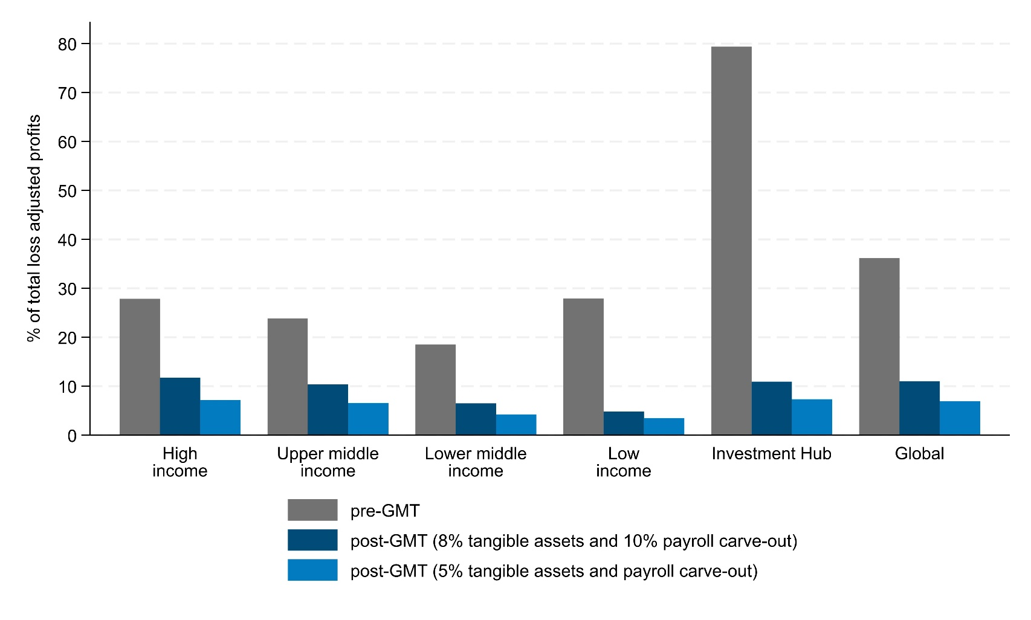
Reduction in global low-taxed profits
% of global profits subject to ETR less than 15%
Overall, reduction in the share of low-taxed MNE profit by 80%, from 36% to 7% of all profit globally after the SBIE transition period
The effect is largest in investment hubs, where the share of low-taxed profit falls from 79% to 7% after the SBIE transition period
Note: The chart refers to the extent to which total profit is low taxed by income groups. Global refers to all jurisdictions. Low taxed profit is defined as those with an ETR (loss-adjusted) lower than 15%. The ‘Pre-P2’ scenario reflects the current distribution of profit absent any GMT effects. The remaining scenarios reflect the distribution of profit once the GMT has applied to low-taxed profit accounting for the year-one and year-ten SBIE, respectively.
Notes:
The increase in the average taxation of MNE profits leads to a global decline in low-taxed profits.
Overall, reduction in the share of low-taxed MNE profit by 80%, from 36% to 7% of all profit globally.
The figure in the slide compares the share of LT profit in total profit by income group before the application of the GMT (in blue) and after the GMT is accounted for (grey and blue).
The decline in low-taxed profits is present for all income groups as we saw in the first paper, all income groups have some low-taxed profits. This reduction is more acute among investment hubs.

Slide 10
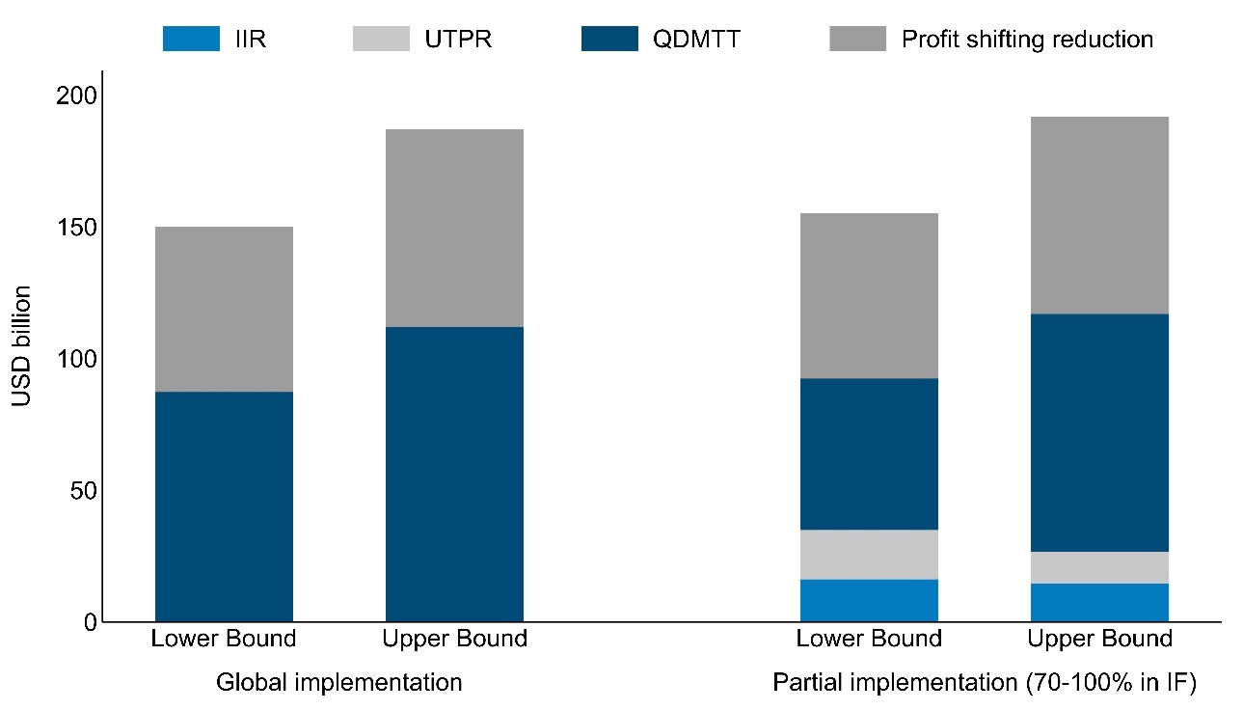
Increase in tax revenue
Global revenue gains by implementation scenario, USD bn
Total global revenue gains of between USD 155 bn and
USD 192 bn per year
  Approx. 2/3 of revenue gains are direct gains via top-up taxation
  Approx. 1/3 of revenue gains are indirect gains through reduced profit shifting
The higher the share of implementing jurisdictions, the higher the share of QDMMT revenue vs. IIR and UTPR revenue
Note: The estimates are presented as an average of the 2017-2020 results. Estimates are presented for IF member jurisdictions only. Estimates include both direct and indirect revenue gains. The estimates account for the variation in the sensitivity of profit shifting. Estimates are presented for the SBIE year-one scenario (10% on payroll and 8% on tangible assets). Estimates are presented net of any lost revenue from CFC regimes modelled. Assumptions on implementation scenarios are discussed above.
Notes:
The last effect of the GMT to discuss is the effect on CIT revenues.
Through the reduction in global low-taxed profits, the GMT is estimated to increase global CIT revenues between USD 155 bn and USD 192bn per year or 6.5 and 8.1% of global CIT revenues on average during the 2017-2020 period. One third of this gain can be ascribed to the reduction of profit shifting; and the remaining 2/3 to top-up taxation.
The figure in the slide represents global revenue gains for IF members under the global and partial implementation scenarios; and disaggregating revenue gains in two ways. First between direct and indirect effects of the GMT. Profit shifting is shown in isolation in grey from the revenue gains from top-up taxation (rest of bars). Second, revenue gains from top-up taxation are disaggregated by the mechanism that collects the top-up tax: QDMTT, IIT, UTPR; which reflect the agreed rule order under the GloBE rules
Under partial implementation, most direct revenues are ascribed to QDMTT showing the relevance of this mechanism to collect top-up taxes. The expansion of QDMTTs implies that less revenue is collected through the other rules, i.e., IIR and the UTPR.
Under global implementation, total revenue gains are slightly lower as some revenues are collected by non-IF jurisdictions. Given that it considers full implementation, all revenue gains are collected through QDMTTs and no revenues are ascribed to the IIR or the UTPR.

Slide 11
Conclusion
The GMT reduces tax rate differentials across jurisdictions
  Reduction in differentials between investment hubs and non-hub jurisdictions by around 50%
  This reduces profit-shifting incentives, and can improve global capital allocation
The GMT is likely to reduce incentives to shift profit
  Estimated fall in global shifted profits by around 50%
The GMT is likely to reduce low-taxed profit globally
  Global amount of MNE profit taxed below 15% is estimated to fall by about 80%
  Remaining low-taxed profit due to SBIE
The GMT is likely to increase tax revenue
  Increased CIT revenues by 6.5%-8.1% of global CIT revenues (USD 155-192 billion in the 2017-2020 period )
  Two-thirds directly, one-third indirectly through reduced profit-shifting

Slide 12
References
Hugger, F., A. González Cabral and P. O’Reilly (2023), "Effective tax rates of MNEs: New evidence on global low-taxed profit", OECD Taxation Working Papers, No. 67, OECD Publishing, Paris, https://doi.org/10.1787/4a494083-en.
Hugger, F., et al. (2024), "The Global Minimum Tax and the taxation of MNE profit", OECD Taxation Working Papers, No. 68, OECD Publishing, Paris, https://doi.org/10.1787/9a815d6b-en.

Slide 13
annex

Slide 14
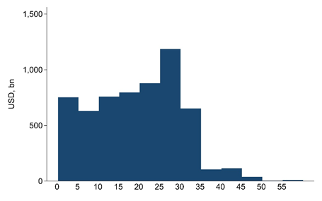
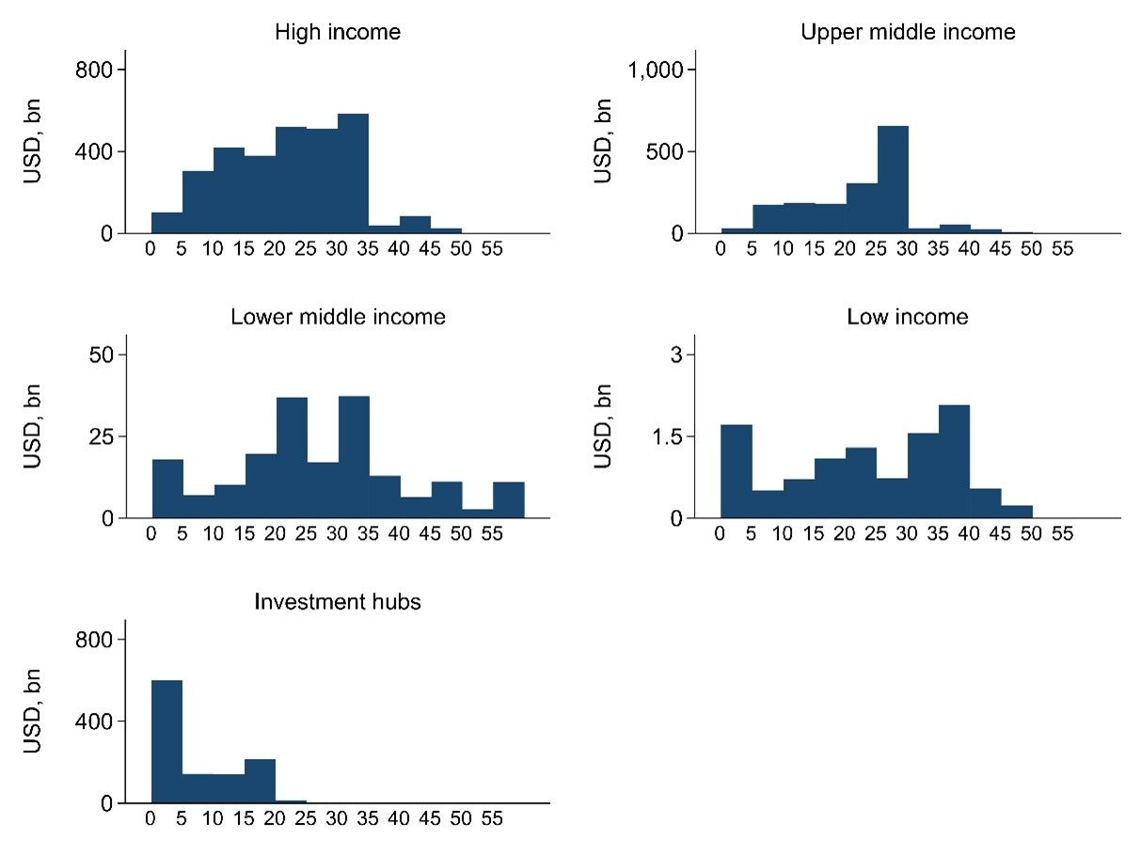
Taxation of profit globally
Distribution of profits across ETR bins globally and by ETR group
Data highlight variety of ETRs across all ETR groups
Concentration of profit in the 25-35% ETR range globally
Concentration in the 0-5% ETR range (including substantial zero-taxed profit)
Note: Distribution of profit of large MNEs across ETR bins, averaged over the period 2017-2020. Bins have a width of five percentage points. The average sum of global profits of large MNEs is USD 5,929 billion per year.

Slide 15
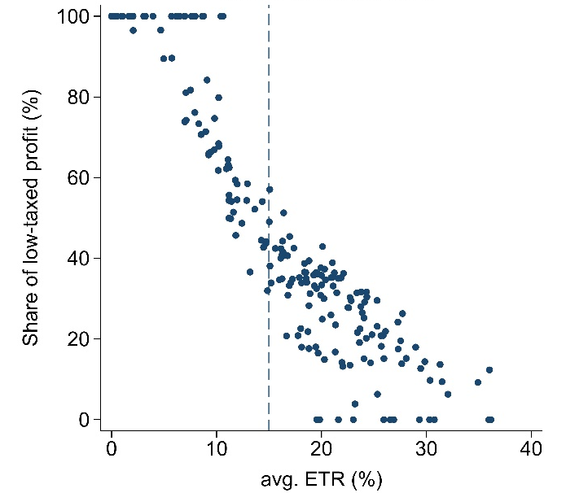
Extent of Low-Taxed Profit compared to average ETRs
Share of low-taxed profit vs. average ETRs
Data show highest shares of low-taxed profits (ETR < 15%) in low-tax jurisdictions
But also substantial low-taxed profits in many jurisdictions with high average ETRs (blue box)
This low-taxed profit in high tax jurisdictions is ignored when only considering average ETRs
Note: Very low-taxed profit compared to the average ETR in a jurisdiction. Each dot is a jurisdiction observation. The vertical line indicates 15%. Values shown are averages across the years 2017-2020 for both shares of low-taxed profit and ETRs. Low-taxed profit is defined as all profit taxed at ETRs below 15%.

Slide 16
Reduction in global low-taxed profits
Distribution of total profits across ETR bins (simplified)
Reduction in profit shifting and top-up taxation reduce global low-taxed profits
The SBIE and other exclusions allows for some profit to remain low-taxed
Overall, reduction in the share of low-taxed MNE profit by 70%, from 36% to 11%
Note: Distribution of profit by effective tax rates bins in three states of the world. The ‘Pre-GMT’ scenario reflects the current distribution of loss adjusted profit absent any GMT effects. The ‘Post-GMT, PS’ scenario captures the distribution of profit once profit shifting incentives are reduced due to the implementation of the GMT. The ‘Post-GMT, PS and top-up (8-10)’ and (5-5) scenarios reflect the distribution of profit once the GMT has applied to low-taxed profit accounting for the year-one and year-ten SBIE, respectively. Profits are computed as averages across ETR bins to ensure a smooth representation.

